Slide 1
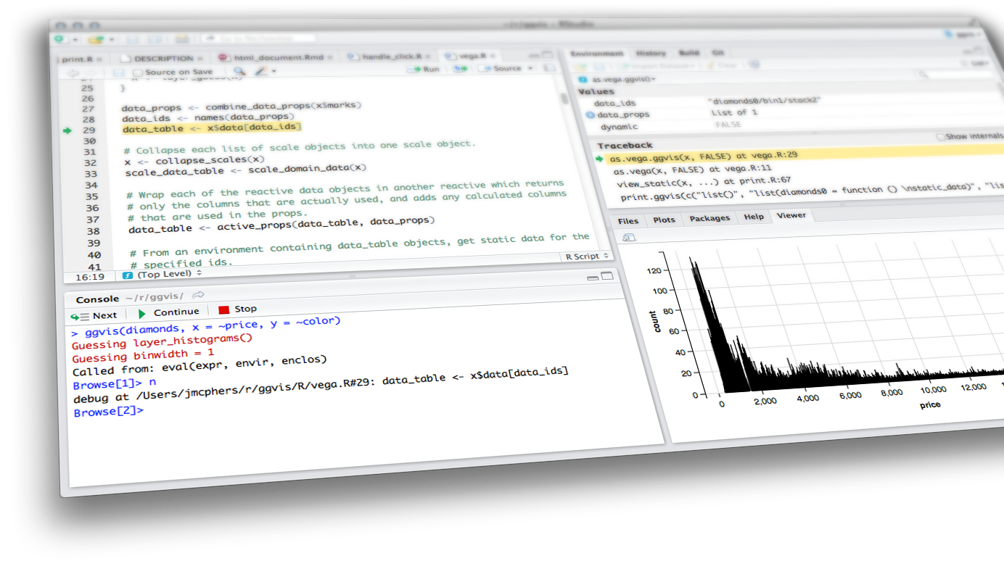

visualizations with Plotly & interactive data
Shiny from

Slide 2
Interactive Visualizations
ggplot2
Building a plot
Refresher
Plotly
ggplotly
plotly standalone
plotly in shiny
Advanced DT
Advanced Reactivity
Reactivity catalog
Reactivity review
Checking preconditions
Time as a reactive source
Limiting rate

Slide 3
“Most of us need to listen to the music to understand how beautiful it is. But often that’s how we present statistics: we just show the notes, we don’t play the music.”
-Hans Rosling

Slide 4
ggplot2 refresh

Slide 5
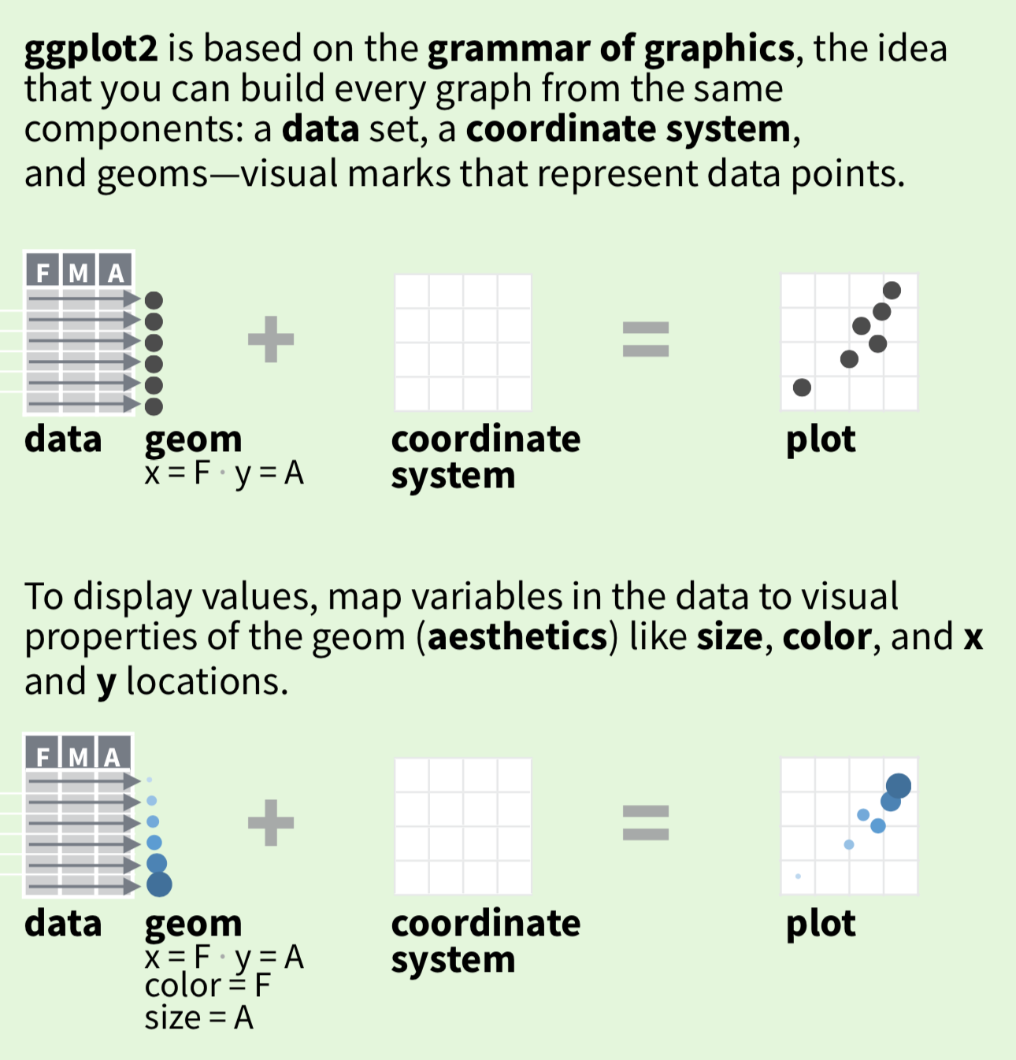
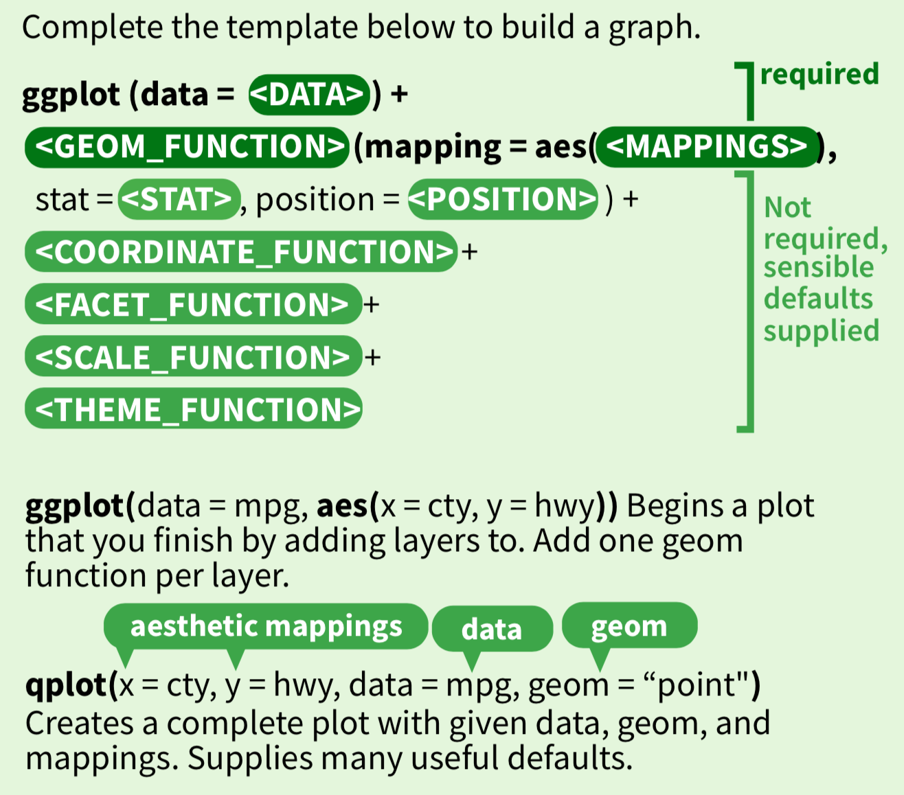
Creating a ggplot
https://www.rstudio.com/resources/cheatsheets/

Slide 6
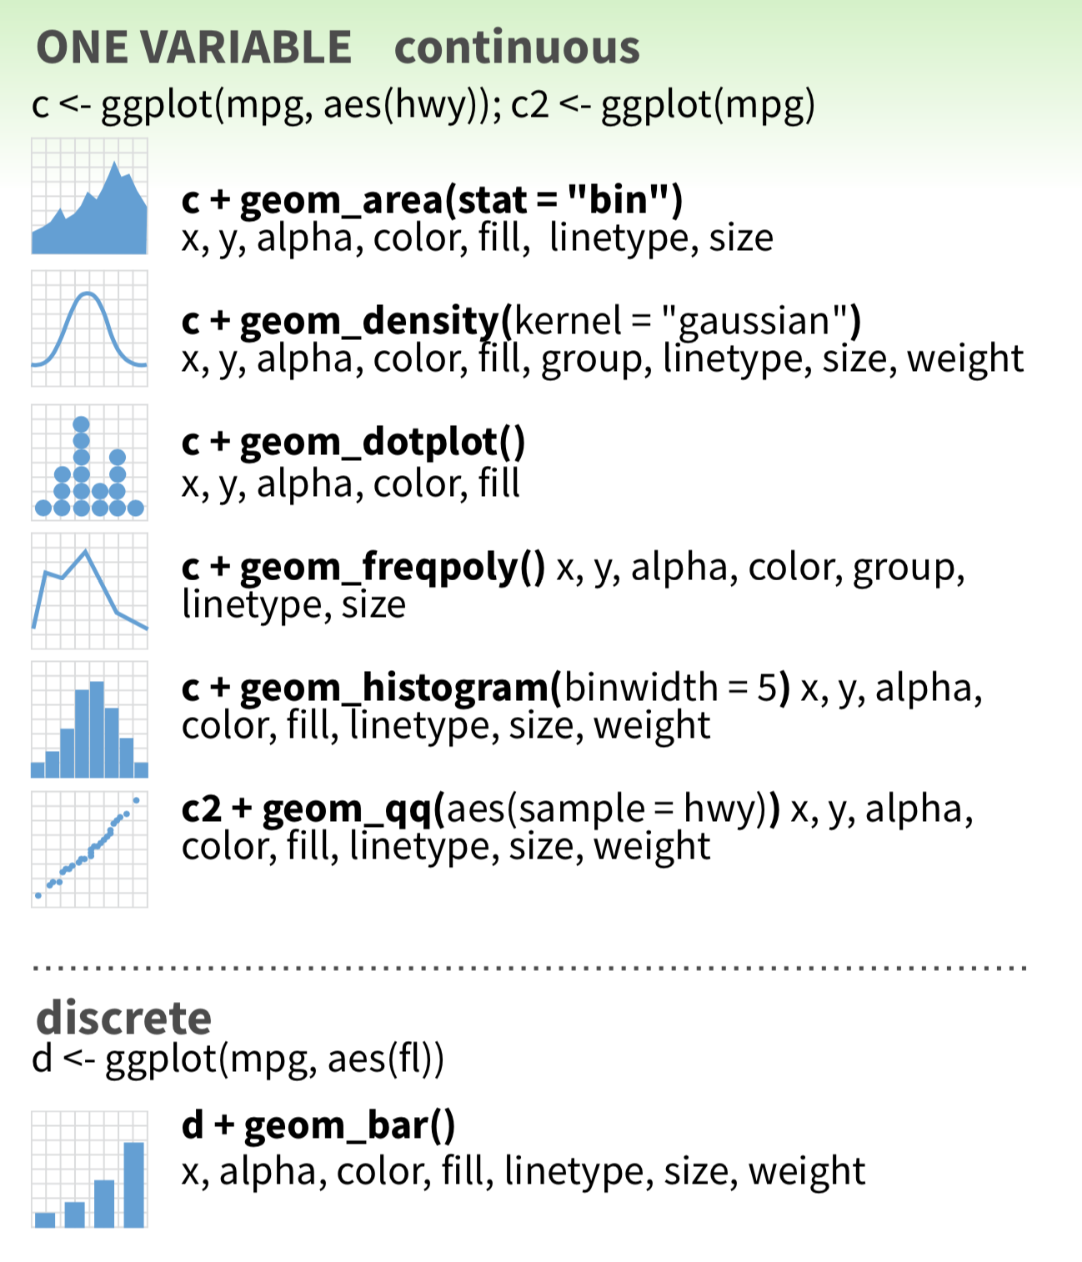
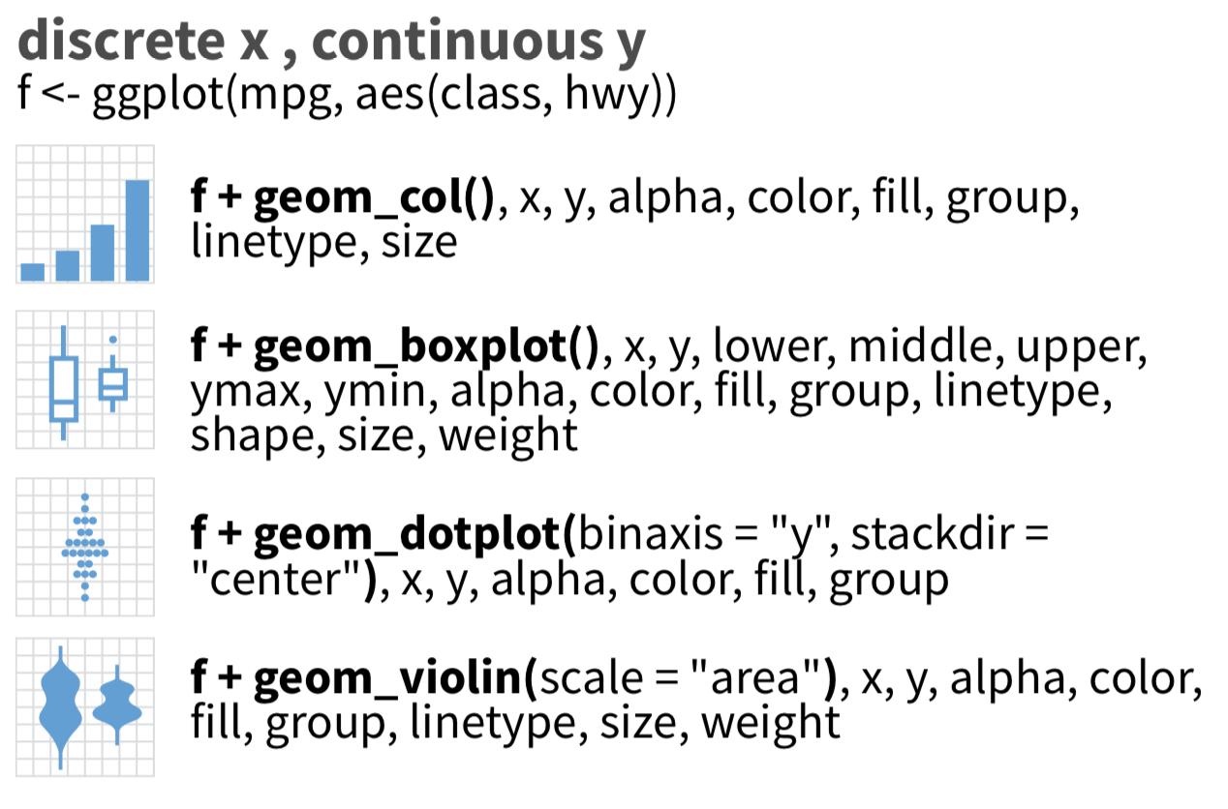
Types of plots
https://www.rstudio.com/resources/cheatsheets/

Slide 7
demo
ggplot(diamonds, aes(x=cut)) +
geom_bar()
Shiny from

Slide 8
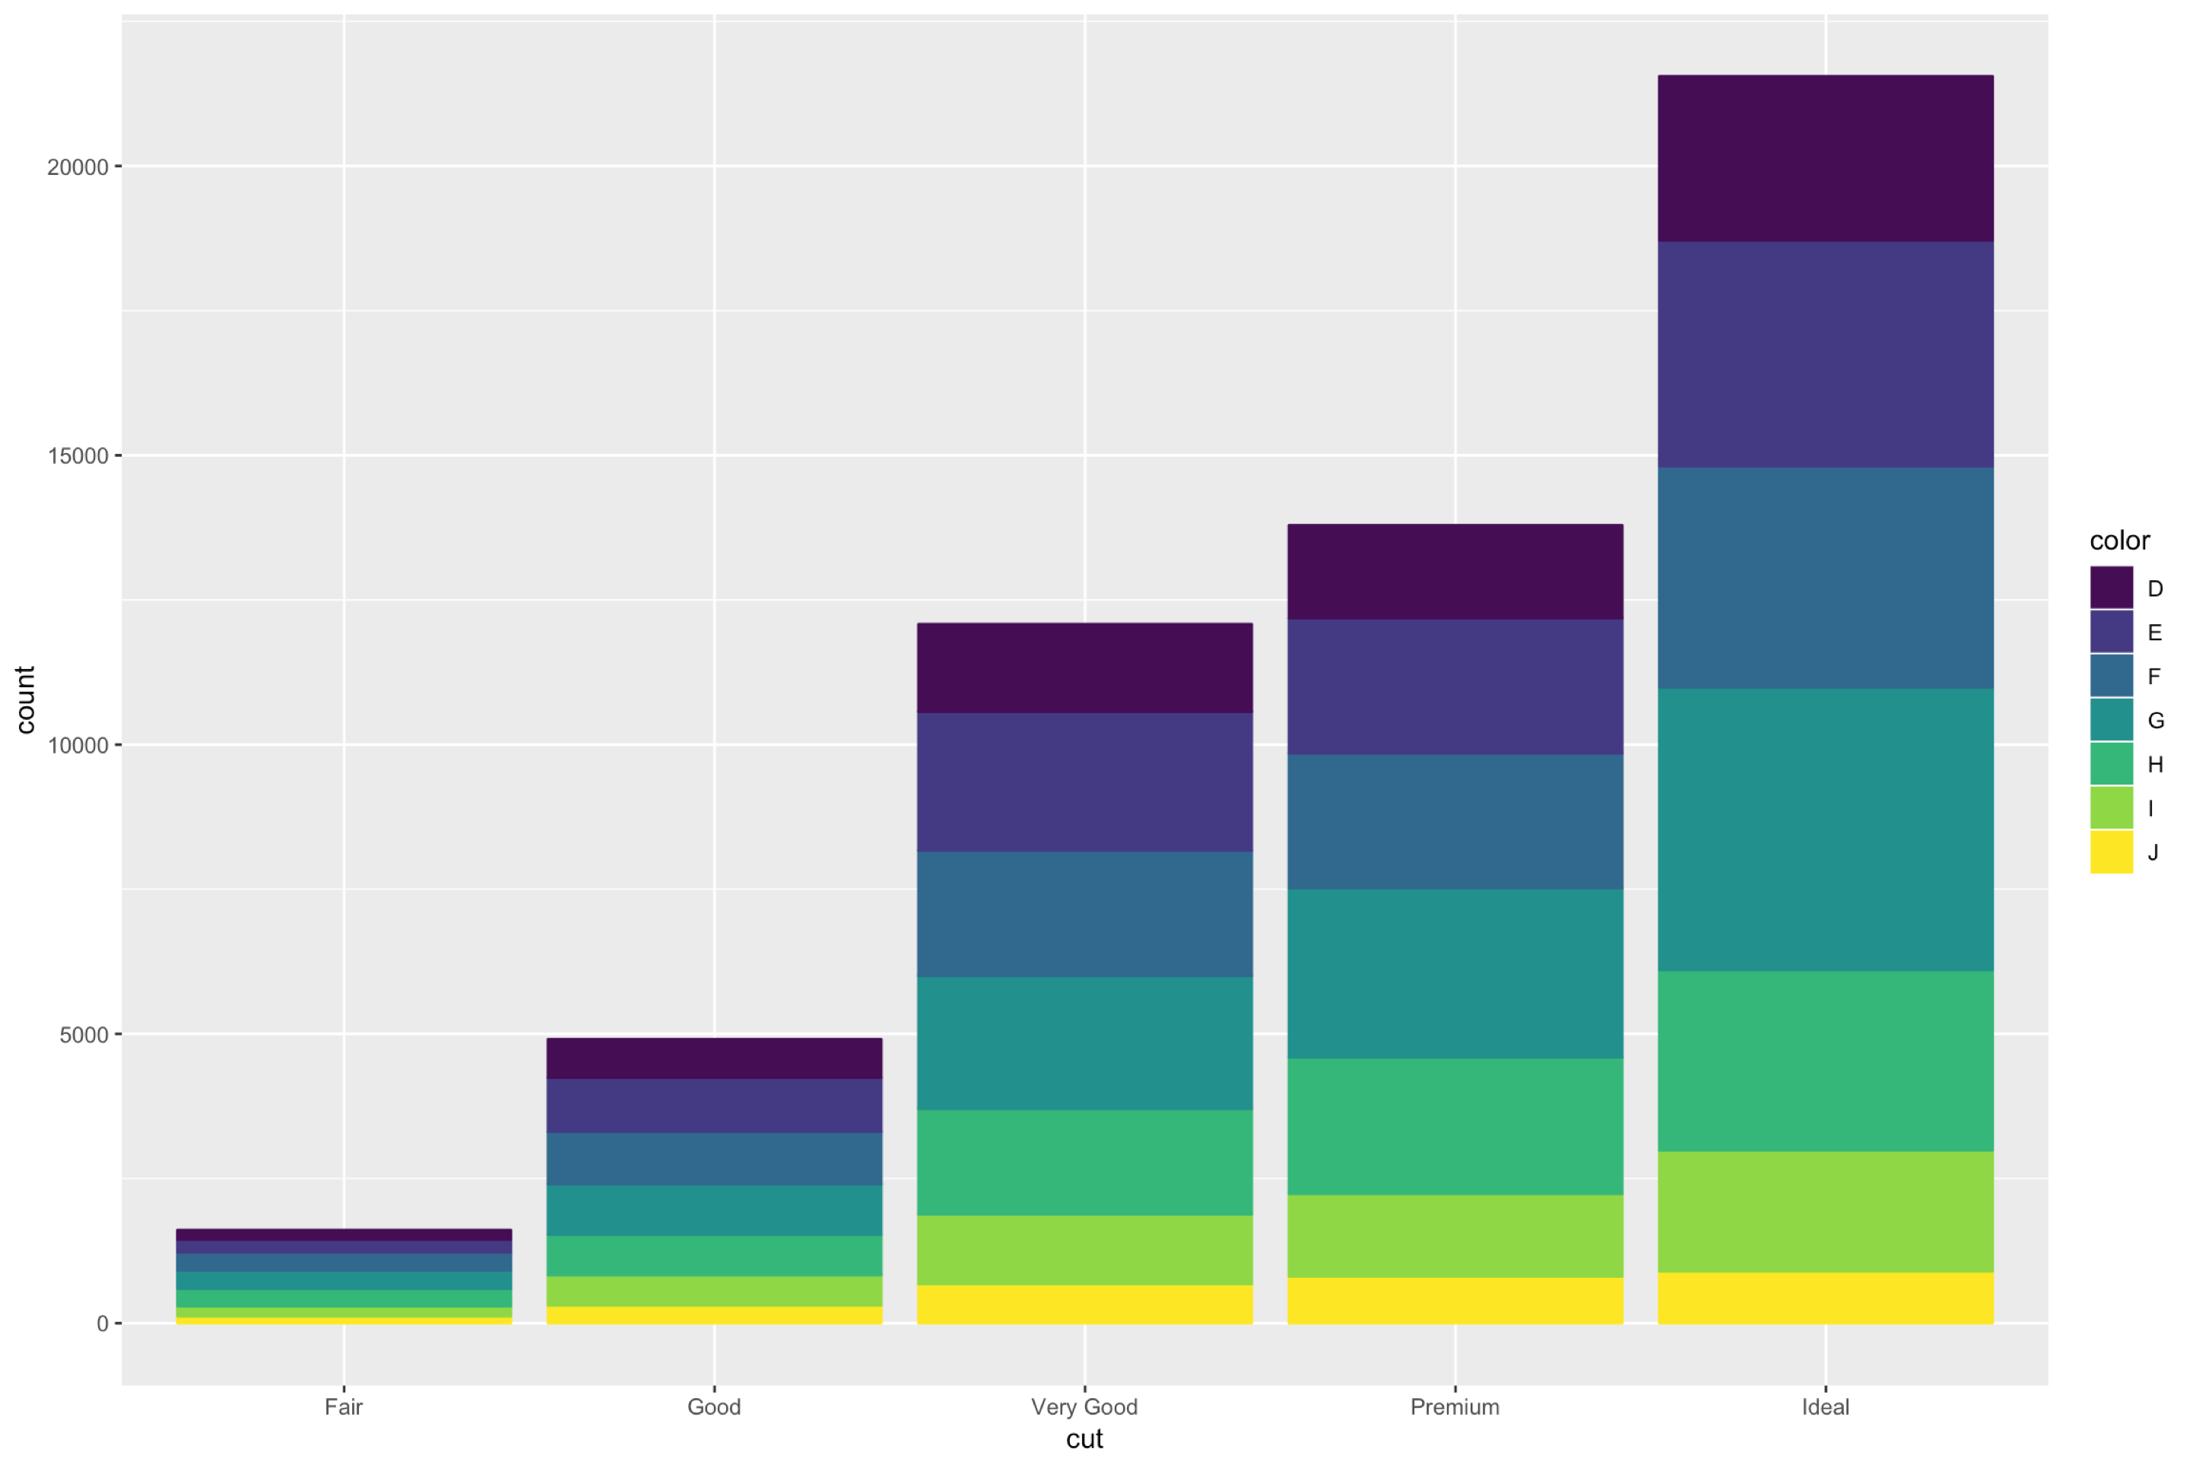

Slide 9
demo
ggplot(mtcars, aes(x = hp, y = mpg)) +
geom_point() +
geom_smooth()
Shiny from

Slide 10
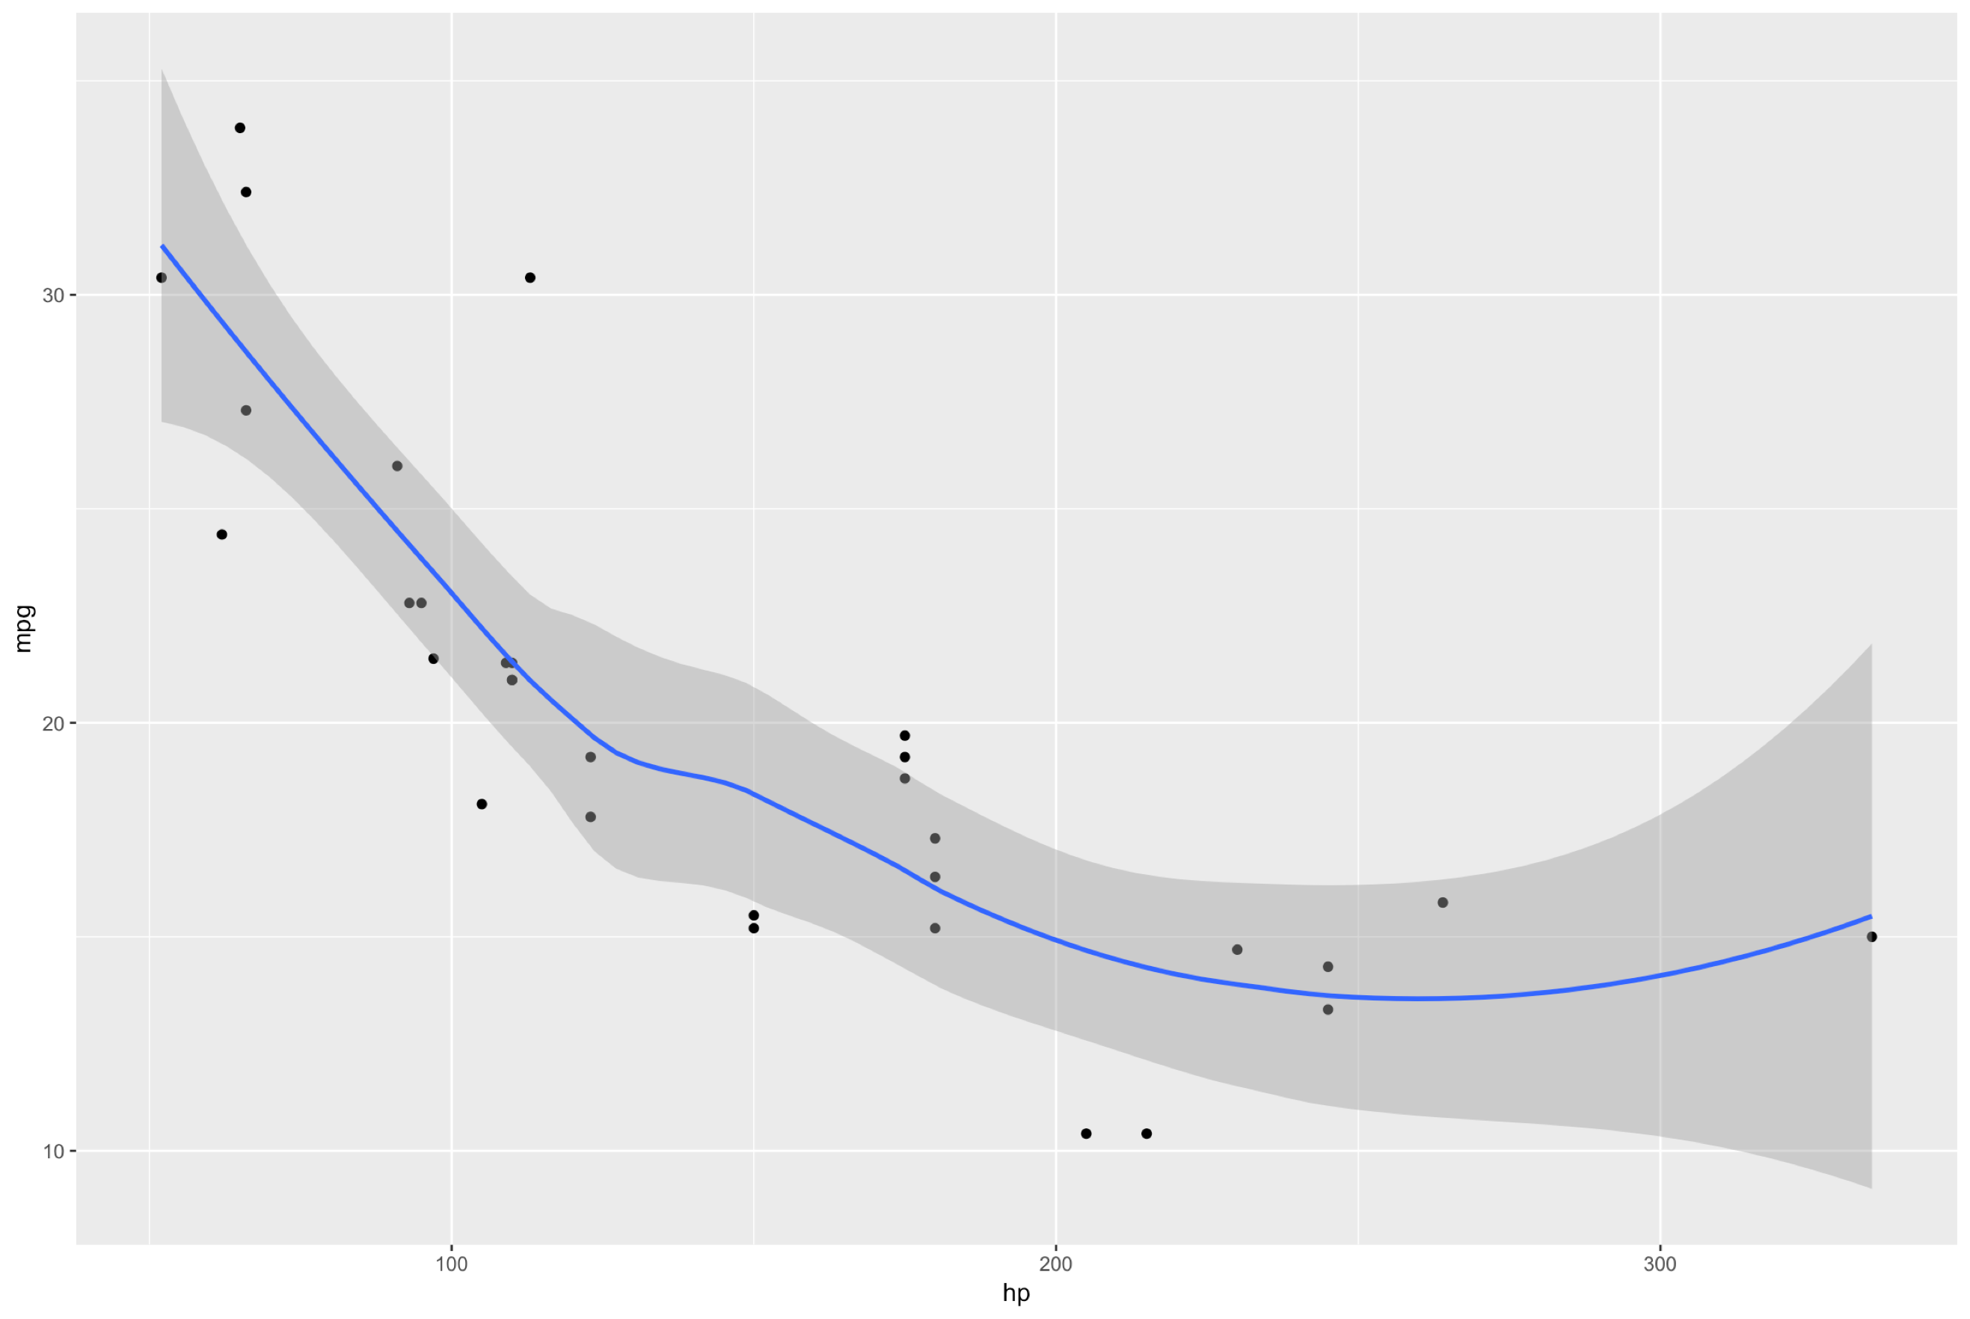

Slide 11

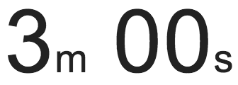
exercise
Build any plot
Use any dataset
Shiny from

Slide 12
demo
Are there any other plots from the markdown file you would like to see?
Shiny from

Slide 13
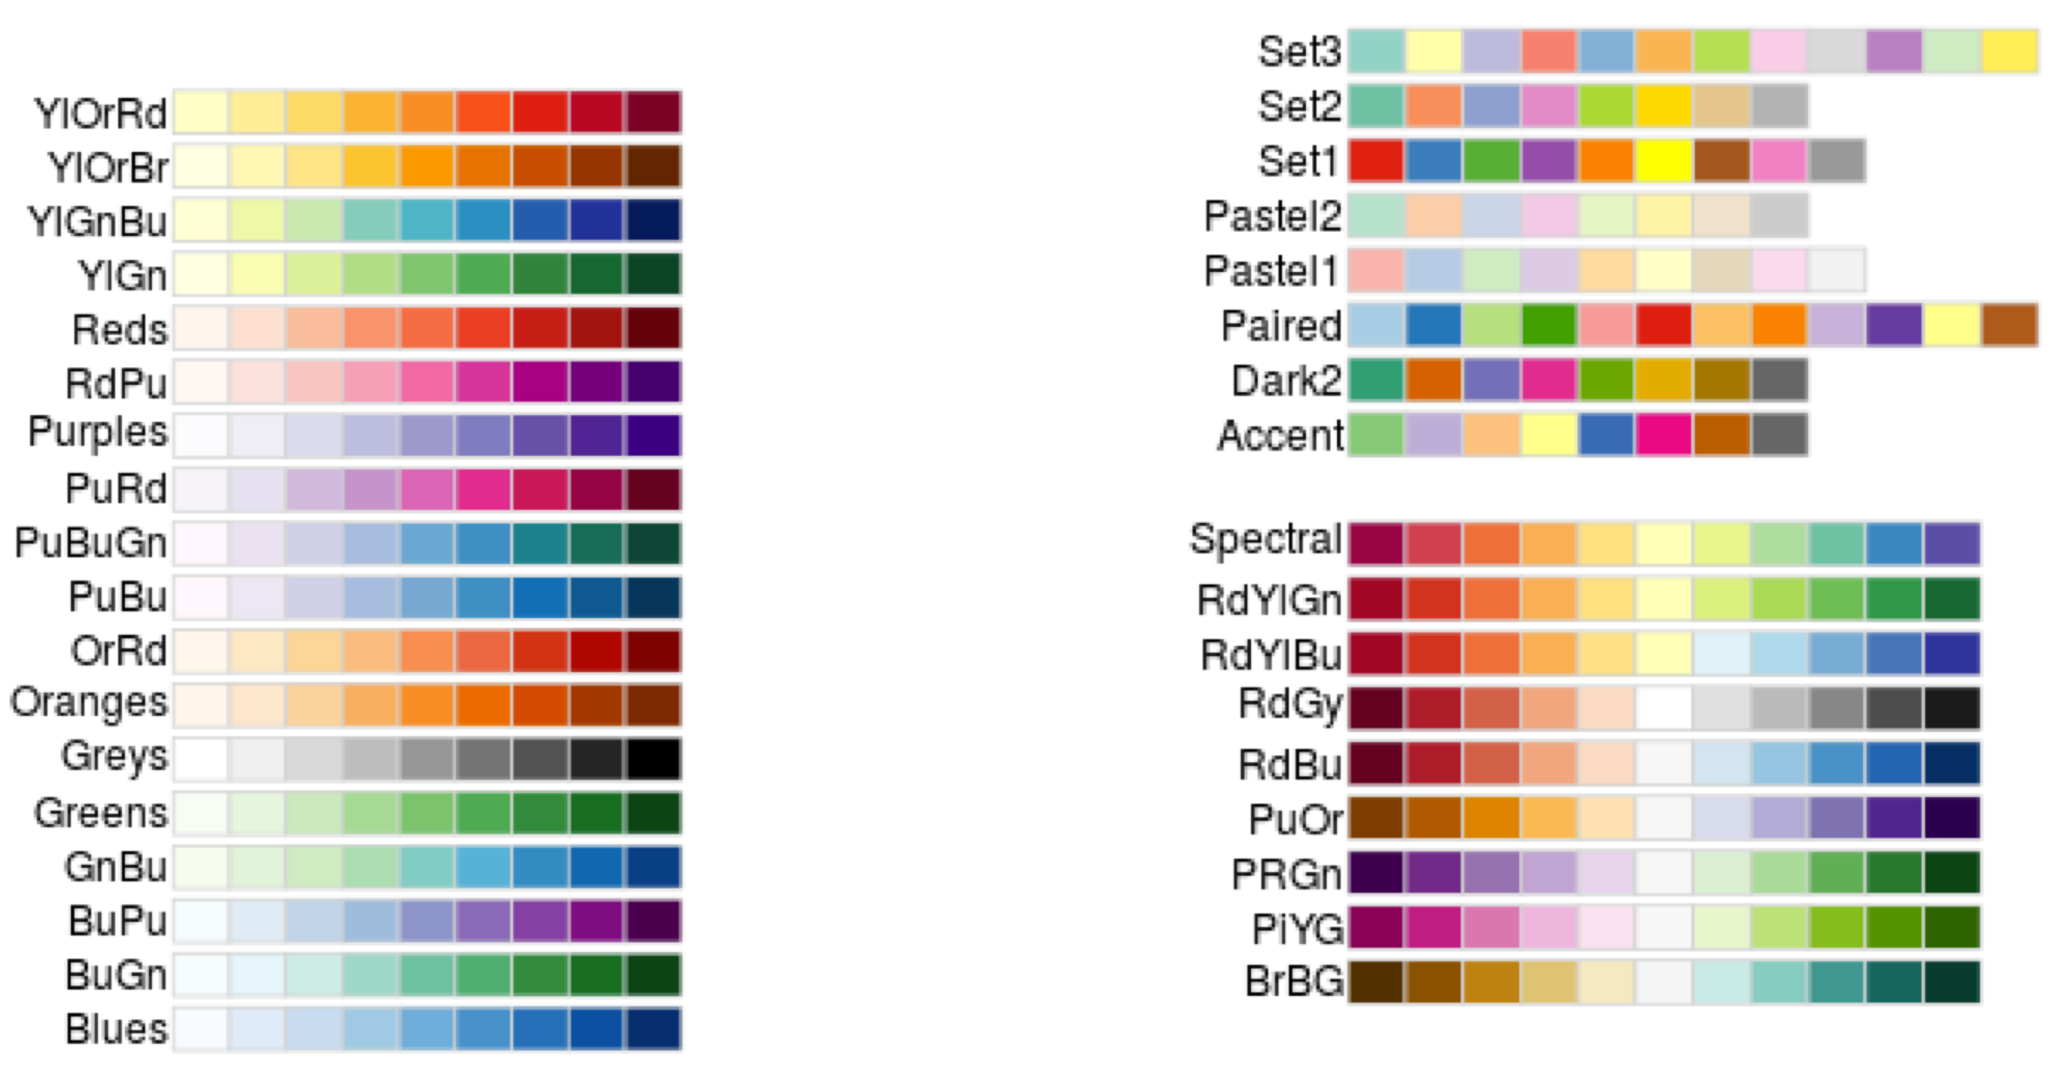
https://colorbrewer2.org/

Slide 14
plotly

Slide 15
ggplotly

Slide 16
demo
ggplotly(
ggplot(mtcars, aes(x = hp, y = mpg)) +
geom_point() +
geom_smooth()
)
Shiny from

Slide 17
demo
ggplotly(
ggplot(mtcars, aes(x = hp, y = mpg) +
geom_point() +
ggtitle("Car Miles per Gallon by Horse Power") +
xlab("Horse Power") +
ylab("MPG"),
tooltip = c("x", "y")
)
Shiny from

Slide 18
demo
ggplotly(
ggplot(mtcars, aes(x = hp, y = mpg, text = paste("<b>”, rowname, "</b><br>",
"MPG:", mpg, "<br>Horse Power:", hp))) +
geom_point() +
ggtitle("Car Miles per Gallon by Horse Power") +
xlab("Horse Power") +
ylab("MPG"),
tooltip = "text"
)
Shiny from

Slide 19
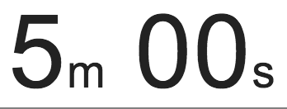
exercise
Warp your previous ggplot
Create a tooltip
Run the code and mess around with the user options in plotly
Shiny from

Slide 20
Other features in plotly
Users can save their output by clicking the camera
You can set tooltip popup type ahead of time
ie: %>% layout(hovermode = 'compare')
You can even combine two plots
ie: subplot(plot1, plot2, nrows = 2, shareX = TRUE, heights = c(.7, .3))
Plotly will recognize most ggplot arguments, but some don’t always come over easily.

Slide 21
plotly standalone

Slide 22
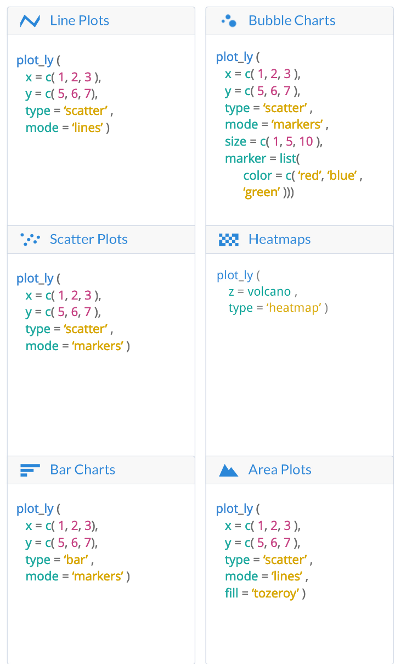
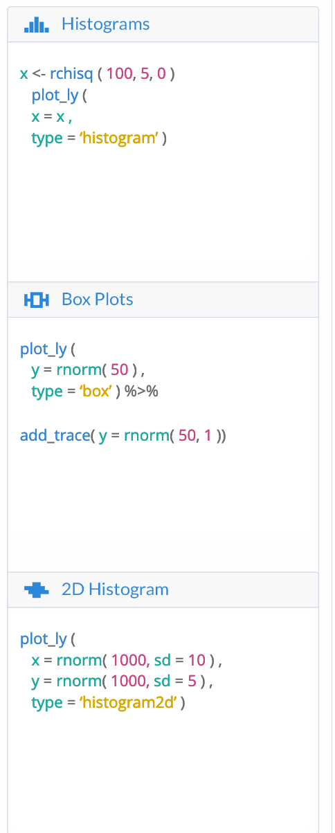
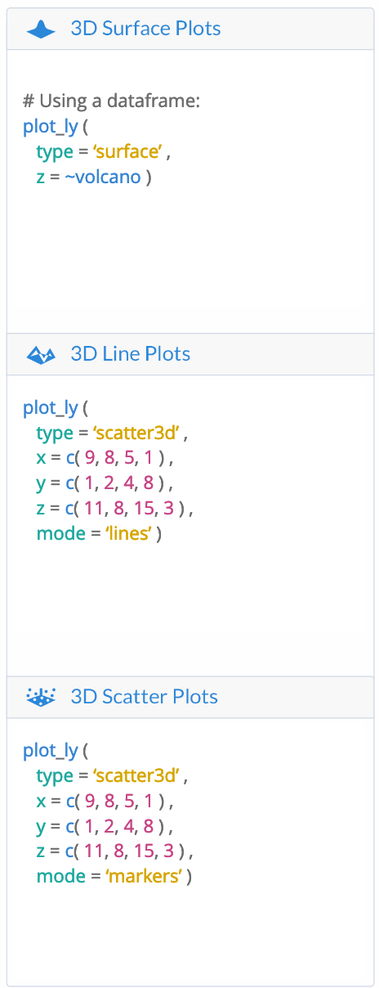
https://images.plot.ly/plotly-documentation/images/r_cheat_sheet.pdf

Slide 23
plotly
in an app

Slide 24
demo
Go to old_faithful.R
Shiny from

Slide 25
exercise
Go to movies_20.R
Edit the UI and Server functions so that scatter plot uses plotly
Create a useful tooltip
Shiny from

Slide 26
Solution
Check your app against movies_21.R
Add library(plotly)
Change plotOuptut to plotlyOutput
Change renderPlot to renderPlotly
Wrap the plot in ggplotly()
Place tooltip as a paste function in aes() and set tooltip = "text"
Or set tooltip = c("x", “y")
Shiny from
© 2016 RStudio, Inc. All rights reserved.

Slide 27
DT
Advanced

Slide 28
DT Options and functions
https://rstudio.github.io/DT/options.html
Determine which elements of the table to display (dom)
Scrolling
Selection
Pages
etc.
https://rstudio.github.io/DT/functions.html
Format Rows based off values
Set row format
etc.

Slide 29
DT Extensions
https://rstudio.github.io/DT/extensions.html
Buttons
Download data (only works on data displayed)
Fixed column/header
Keeps certain columns or header from scrolling
Scroller

Slide 30
demo
Go to movies22.R
Shiny from

Slide 31
advanced reactivity
Shiny from

Slide 32
Reactivity
catalog

Slide 33
reactivity catalog
Store values: reactiveValues / input / makeReactiveBinding
Calculate values: reactive / eventReactive
Execute tasks: observe / observeEvent
Preventing reactivity: isolate
Checking preconditions: req
Time (as a reactive source): invalidateLater / reactiveTimer (invalidateLater is a safer and simpler alternative)
Rate-limiting: debounce / throttle
Live data: reactiveFileReader / reactivePoll
(Pretty sure this is just the beginning...)

Slide 34
reactivity catalog
Store values: reactiveValues / input / makeReactiveBinding
Calculate values: reactive / eventReactive
Execute tasks: observe / observeEvent
Preventing reactivity: isolate
Checking preconditions: req
Time (as a reactive source): invalidateLater / reactiveTimer (invalidateLater is a safer and simpler alternative)
Rate-limiting: debounce / throttle
Live data: reactiveFileReader / reactivePoll
(Pretty sure this is just the beginning…)
Highlighted functions are fundamental, all others are built on top.

Slide 35
Reactivity
review

Slide 36
review: reactive expressions
Use to calculate new values based on reactive values and other reactive expressions.
Caches its return value, until notified of reactive dependencies being out-of-date.
Lazily executes — Shiny wants to avoid running these whenever possible. For this reason, meaningful side effects are prohibited from reactive expressions.
Call it like a function when you want to read its value.

Slide 37
review: reactive expressions
# Declare
movies_subset <- reactive({
movies %>% filter(title_type %in% input$type)
})
# Read
output$scatterplot <- renderPlot({
ggplot(movies_subset(), aes(...)) + geom_point()
})

Slide 38
review: observers
Use to execute actions based on changing reactive values and other reactive expressions.
Doesn't return a value. So performing side effects is usually the only reason you'd want to create one of these.
Eagerly executed by Shiny.
observe({
print(paste("The value of x is", input$x))
})
## [1] The value of x is 10
## [1] The value of x is 16
## [1] The value of x is 9

Slide 39
reactive expressions vs. observers
reactive() | observer()
Callable | Not callable
Returns a value | No return value
Lazy | Eager
Cached | N/A
No side effects | Only for side effects

Slide 40
reactive expressions vs. observers vs. functions
reactive() | observer() | function()
Callable | Not callable | Callable
Returns a value | No return value | Returns a value
Lazy | Eager | Lazy
Cached | N/A | Not cached
No side effects | Only for side effects | Side effects optional

Slide 41
observeevent vs. eventreactive
Every reactive expression or reactive value read by a reactive() or observe() block automatically becomes a reactive dependency of that reactive expression/observer.
observeEvent and eventReactive give us finer control.
observeEvent(input$save_button, {
write.csv(movies_subset(), "movies.csv")
})
"When the save_button button is clicked, write the value of movie_subset to disk." (Don't write to disk automatically when movie_subset changes.)

Slide 42
observeevent and eventreactive
observeEvent is for event handling
eventReactive is for delayed computation
observeEvent(when_this_changes, {
do_this
})
r <- eventReactive(when_this_changes, {
recalculate_this
})
Use these functions when you want to explicitly name your reactive dependencies, as opposed to letting reactive/observe implicitly depend on anything they read.

Slide 43
exercise
Open apps/adv-reactivity/cranlogs.R and run it. This app has several problems:
We get an error right off the bat — the plot is running before the user has specified any packages.
Unless you're a very fast typist, typing package names will cause the cranlogs server to be queried with many incomplete queries.
Add an "Update" actionButton to the UI, and make sure nothing happens until it's clicked.
Shiny from
© 2016 RStudio, Inc. All rights reserved.

Slide 44
Solution
See cranlogs-solution.R
packages <- reactive({
strsplit(input$packages, " *, *")[[1]]
})
packages <- eventReactive(input$update, {
strsplit(input$packages, " *, *")[[1]]
})
Shiny from
© 2016 RStudio, Inc. All rights reserved.

Slide 45
review: reactive values
Read/write versions of input.
Try not to use this to store calculated values. But in some cases, it's unavoidable.
# Create
rv <- reactiveValues(x = 10)
# Read
rv$x
# Write
rv$x <- 20

Slide 46
exercise
Open the file apps/adv-reactivity/counter.R. It has three action buttons:
Increment: Increase the value by 1
Decrement: Decrease the value by 1
Reset: Set the value to 0
Unfortunately, it doesn't work. See if you can implement the server side.
Shiny from
© 2016 RStudio, Inc. All rights reserved.

Slide 47
Solution
See counter-solution.R
rv <- reactiveValues(count = 0)
observeEvent(input$increment, {
rv$count <- rv$count + 1
})
observeEvent(input$decrement, {
rv$count <- rv$count - 1
})
observeEvent(input$reset, {
rv$count <- 0
})
output$value <- renderText({
rv$count
})
Shiny from
© 2016 RStudio, Inc. All rights reserved.

Slide 48
when to use reactivevalues
Don't use reactiveValues when you're calculating a value based on other values and calculations that are already available to you.
Do use reactiveValues to store state that otherwise would be lost from your graph of reactive objects.

Slide 49
reactivevalues example 1
(1) A calculation over the history of something reactive:
observeEvent(input$add, {
rv$total <- rv$total + input$x
})
(Or a more elegant way to do the same, using hadley/shinySignals:)
total <- shinySignals::reducePast(reactive(input$x), `+`, 0)

Slide 50
reactivevalues example 2
(2) Tracking which of several events happened most recently:
observeEvent(input$editMode, {
rv$mode <- "edit"
})
observeEvent(input$previewMode, {
rv$mode <- "preview"
})
output$page <- renderUI({
if (rv$mode == "edit") {
...
} else if (rv$mode == "preview") {
...
}
})

Slide 51
reactivevalues example 3
(3) To change rules of reactivity:
Normally, as soon as reactive expressions are invalidated (before they have recalculated) they invalidate everyone downstream who depends on them.
But sometimes recalculating will end up giving us the same value as the previous anyway, and any downstream recalculations might have been wasted work.
dedupeReactive <- function(rexpr, priority = 10) {
rv <- reactiveValues(value = NULL)
observe({
rv$value <- rexpr() # TODO: Handle errors
}, priority = priority)
reactive(rv$value)
}

Slide 52
preventing reactivity with isolate
Use isolate from inside a reactive expression or observer, to ignore the implicit reactivity of a piece of code.
Wrap it around expressions or a whole code block.

Slide 53
exercise
Determine when r1, r2, and r3 update:
r1 <- reactive({
input$x * input$y
})
r2 <- reactive({
input$x * isolate({ input$y })
})
r3 <- reactive({
isolate({ input$x * input$y })
})
Shiny from
© 2016 RStudio, Inc. All rights reserved.

Slide 54
Solution
# Updates every time input$x or input$y change
r1 <- reactive({
input$x * input$y
})
# Updates only when input$x changes
r2 <- reactive({
input$x * isolate({ input$y })
})
# Never updates; it will always have its original value
r3 <- reactive({
isolate({ input$x * input$y })
})
Shiny from
© 2016 RStudio, Inc. All rights reserved.

Slide 55
Checking
preconditions

Slide 56
checking preconditions with req
Cancel the current output (or observer) if a condition isn't met.
req(input$text): Ensure the user has provided a value for the "text" input
req(input$button): Ensure the button has been pressed at least once
req(x %% 2 == 0): Ensure that x is an even number
req(FALSE): Unconditionally cancel the current reactive, observer, or output

Slide 57
checking preconditions with req
req(cond) is similar to:
stopifnot(cond)
if (!cond) stop()
assertthat::assert_that(cond)
but with these differences:
Errors during output rendering show up with bold red text in the UI; req just makes the output blank
Rather than verifying that cond is true, req verifies that cond is truthy (see ?isTruthy)
Feels unnatural to be so arbitrary and nebulous, but this definition is just too practical for UI programming
Most importantly, req is like an error in that it "infects" the downstream elements of the reactive graph (if a reactive throws an error, then any other reactive/observer/output that tries to access it will also throw an error)

Slide 58
exercise
Open dynamic.R and run it.
It has lots of errors in the browser and the R console — ignore those for the moment.
From the app, upload the diamonds.csv file found in the same directory. Now everything looks good.
See if you can figure out why these errors appear when the app first comes up, and how you can get them to go away (first without req, and then, if you have time and can figure out how, using req).
Shiny from
© 2016 RStudio, Inc. All rights reserved.

Slide 59
Solution
Antisolution:dynamic-antisolution.R.
This is how you used to have to do it: check for missing values yourself, and return(NULL).
You had to do this in every reactive, observer, or output that could have a missing value, plus all of the reactives, observers, and outputs that are downstream!
Solution: dynamic-solution.R.
Now you can use req in the reactives, observers, and outputs that directly use potentially-missing inputs, and everything downstream can just not worry about it.
Shiny from
© 2016 RStudio, Inc. All rights reserved.

Slide 60
Time as a
reactive source

Slide 61
exercise
What will this prouduce?
ui <- basicPage( verbatimTextOutput(“text") )
server <- function(input, output){
r <- reactive({ Sys.time() })
output$text <- renderPrint({ r() })
}
shinyApp(ui, server)
An app that reports Sys.time() at the time of first launch, and then doesn’t update it
Shiny from
© 2016 RStudio, Inc. All rights reserved.

Slide 62
exercise
What will this prouduce?
ui <- basicPage( verbatimTextOutput(“text") )
server <- function(input, output){
r <- reactive({
invalidateLater(1000)
Sys.time()
})
output$text <- renderPrint({ r() })
}
shinyApp(ui, server)
An app updates reported Sys.time() every second
Shiny from
© 2016 RStudio, Inc. All rights reserved.

Slide 63
Limiting
rate

Slide 64
debounce and throttle
If a reactive value or expression changes too fast for downstream calculations to keep up, you can end up with a bad user experience (laggy experience, wasted work).
debounce and throttle take a reactive expression object as input, and return a rate-limited version of that reactive expression.
# A reactive that updates as often as every 50 milliseconds
fast_reactive <- reactive({ ... })
# A reactive that updates no more often than every 2000 milliseconds
throttled_reactive <- throttle(fast_reactive, 2000)
# A reactive that doesn't update until fast_reactive has stopped
# changing for at least 1000 milliseconds
debounced_reactive <- debounce(fast_reactive, 1000)

Slide 65
exercise
Open and run points.R. Click on the plot a few times to create points. Notice the annoying laggy behavior — this is due to a (simulated) expensive summary output.
Use debounce or throttle to prevent the summary output from running so often.
Shiny from
© 2016 RStudio, Inc. All rights reserved.

Slide 66
Solution
See points-solution.R
Shiny from
© 2016 RStudio, Inc. All rights reserved.

Slide 67
advanced reactivity
Shiny from

